Slide 1
ENSE 496AB
Milestone 2
Health-Esteem
October 11th, 2018
Jennifer Herasymuik | Shawn Clake
Tristan Heisler | Quinn Bast
Wilson Nie | Chengyu Lou
Notes:
Shawn

Slide 2
Team Introductions
Team Members:
Jennifer Herasymuik
Shawn Clake
Tristan Heisler
Quinn Bast
Wilson Nie
Chengyu Lou
Team Name:
Health-Esteem
Assigned Project:
Braintrust
Notes:
Shawn

Slide 3
USM Review and Rationalization
Envisioned Features
Idea creation, submission, viewing and progression. Account lifecycle, session management and homepage.
Changes in the USM
Our only change in release 1 was the addition of an error page. The detailed information within this error page has been added to release 3 (Milestone 4).
Rationalization
This release supports all core functionality of the desired application and could theoretically be used to progress an idea through the PDCA flow.
Notes:
Quinn

Slide 4
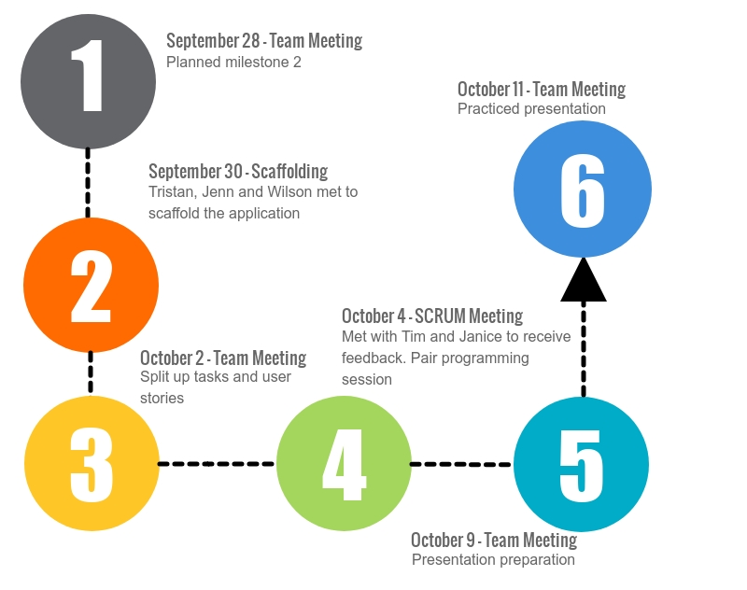
Timeline
Notes:
Quinn

Slide 5
Contributions
Team Member Main Priorities
Quinn/Tristan/Oscar - Idea Filtering, Creation and Viewing
Jenn - Database Design, Point System
Shawn/Wilson - Login, Account Creation, Error Pages, Navigation, Homepage
There was overlap of these responsibilities among other group members.
Ie. Tristan, Jenn, and Wilson scaffolded the application.
Ie. Tristan and Shawn used pair programming to implement division to unit filtering on Idea creation.
Notes:
Wilson

Slide 6
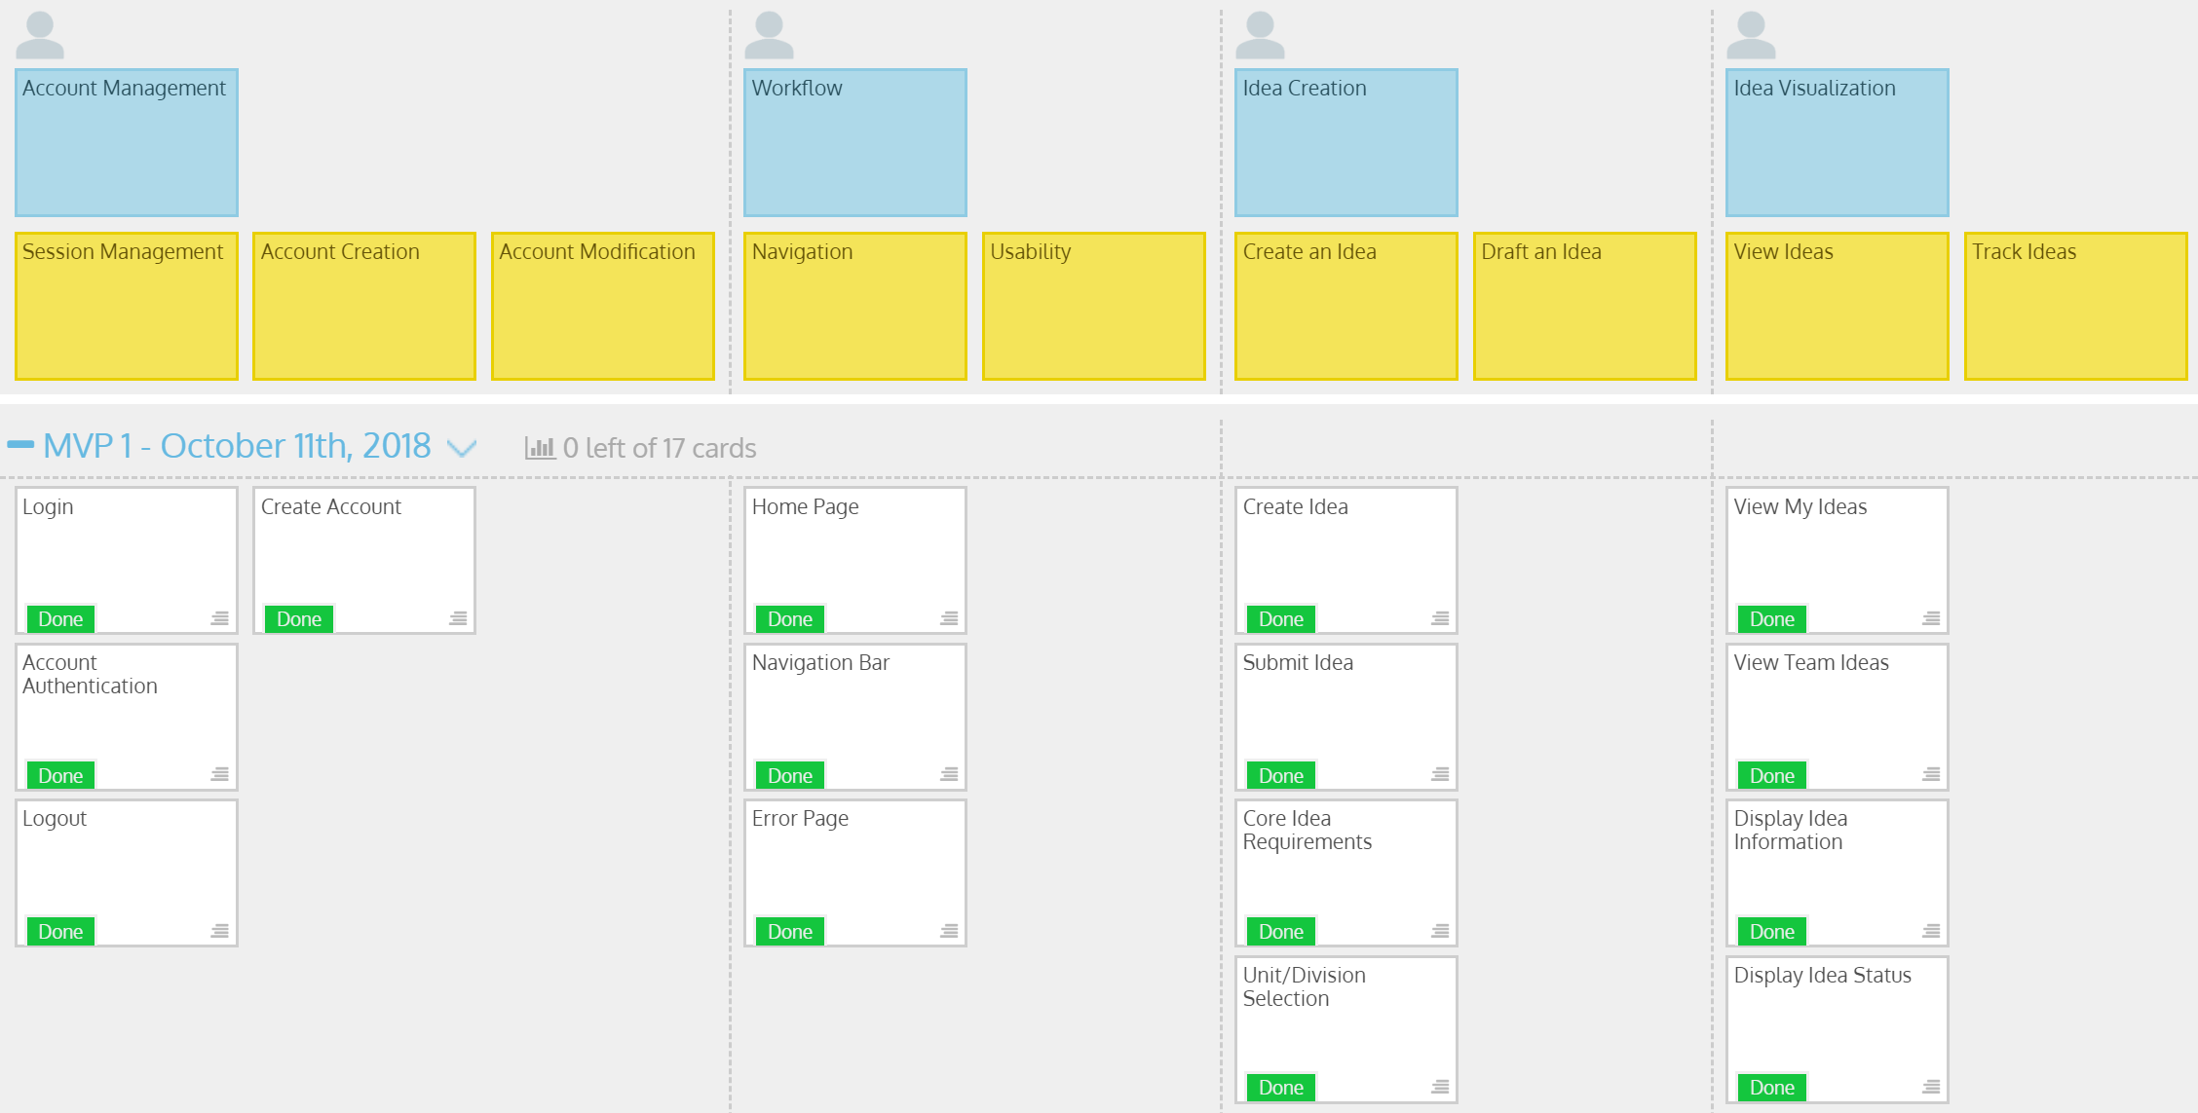
MVP 1/Milestone 2 USM
Notes:
Tristan

Slide 7
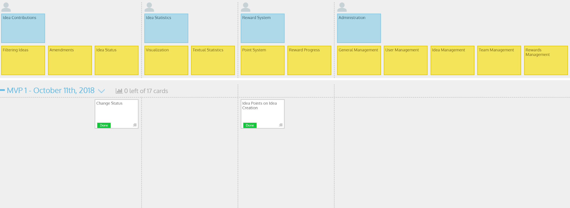
MVP 1/Milestone 2 USM (cont.)
Notes:
Tristan

Slide 8
Milestone 2
Demo
Health-Esteem
Notes:
Tristan

Slide 9
Discussion
Success
Each person had a defined role within the team for MVP 1 and will likely maintain a similar role in the future.
Completed all the tasks in MVP 1 and working on tasks from future MVPs.
Barriers
Difficult to get started with .NET Core.
Groups sizes are large which causes difficulty when scheduling meetings.
Contributions appear skewed by flashiest features and commits rather than by time invested. i.e Database design is difficult to track/present
Notes:
Oscar

Slide 10
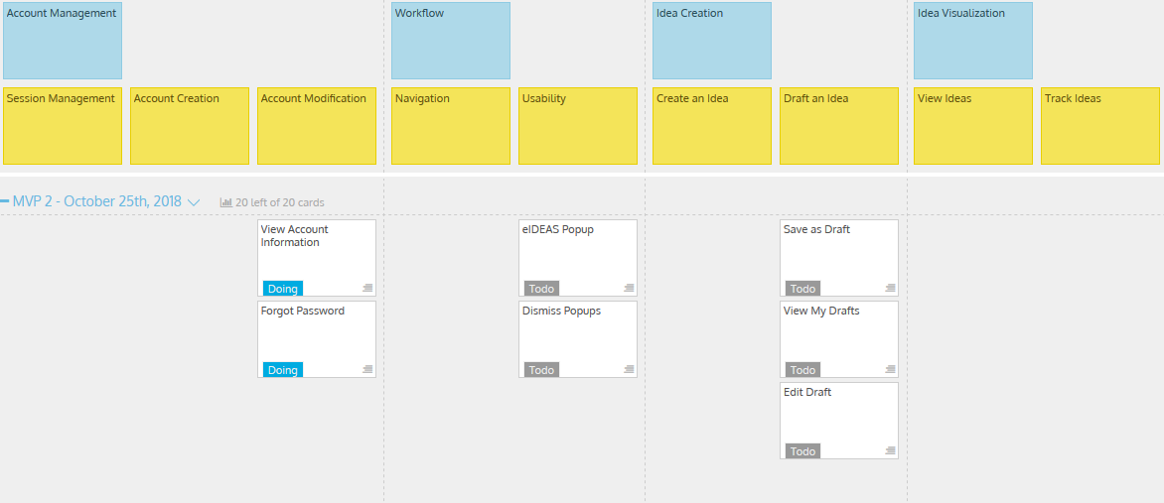
MVP 2/Milestone 3 USM
Notes:
Jenn

Slide 11
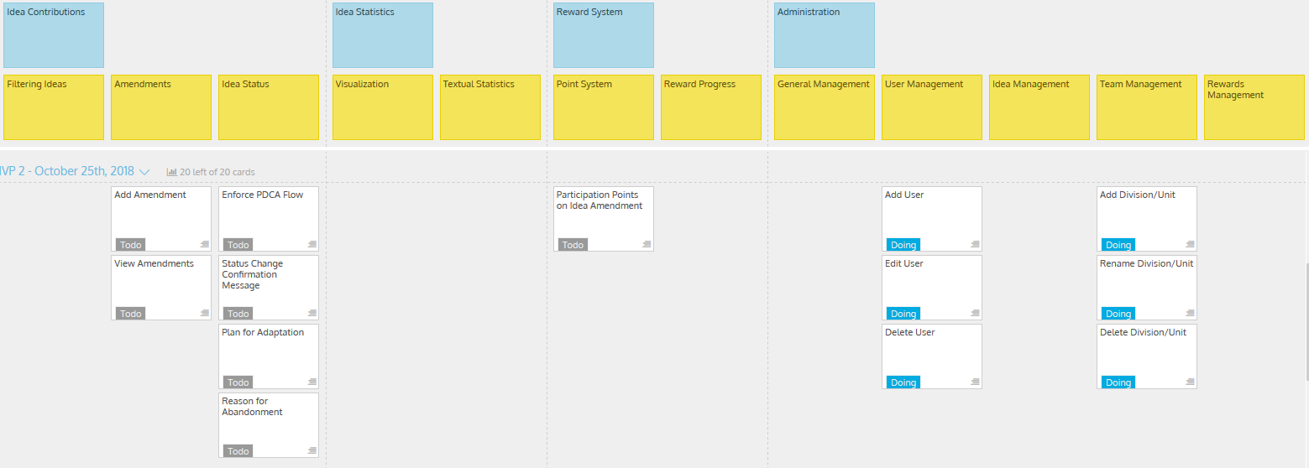
MVP 2/Milestone 3 USM (cont.)
Notes:
Jenn

Slide 12
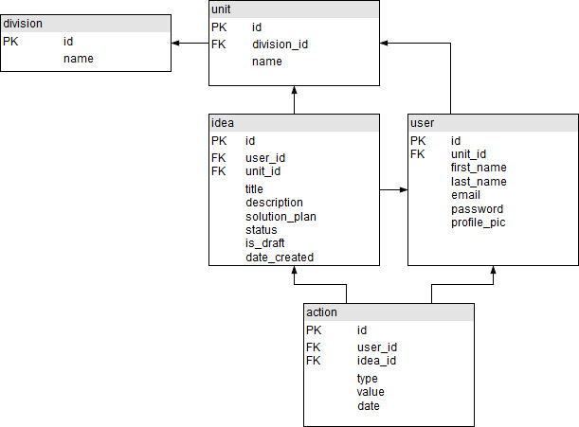
Database Design - Current UML
Notes:
Jenn

Slide 13
Miscellaneous
Environments
Environment variables
Handling routing and styling based on environment
Stack traces in dev, pretty error messages in production
Hiding Pages from Unauthorized Users
Redirect unauthorized users to the login page
Prevent users manually entering valid URL to reach pages they should not access
Documentation
User Acceptance Tests - spreadsheet created and used for quality assurance
User Manual - In progress
Notes:
Wilson

Slide 14
Group Reflection
How do you feel about this milestone? What do you like about it? What did you dislike?
Like: Code generators remove the boiler plate work allowing us to focus on features.
Dislike: Code generators create hidden files that appear to work like magic.
Dislike: Running database migrations had inconsistencies (caching?).
Dislike: Detailing individual accomplishments can reduce team cohesion.
Worried about perceived individual contributions over team success
What did you learn about yourself as you collaborated and worked through this milestone?
We learned how to pool our knowledge to determine solutions for the tasks at hand.
Notes:
Shawn

Slide 15
Group Reflection (cont.)
How will you use what you have learned going forward?
We will work together to brainstorm solutions to problems we encounter while implementing user stories.
What “stuff & things” related to this milestone would you want help with?
Best practices for generating/scaffolding the application including folder structure, hidden files and pathing.
Feedback on this MVP to improve future MVPs.
Notes:
Shawn

Slide 16
Questions?
Notes:
Shawn

